Slide 1
Lecture 11, still lesson 8: Simple harmonic motion
Teacher: Paul Briard

Slide 2
About quick test of Wednesday
Everything we have seen together until now,
Included the rotation of rigid bodies (and included the angular momentum we have described last week)
excluded the simple harmonic motion.

Slide 3
About quick test of Wednesday
Duration of the quick test: 45 minutes
Rules: same than for examination:
Chinese-English dictionary allowed
Calculator without memory allowed (you could have forgotten to buy one, or you could forgot to take it at the test, in that case, you try to calculate the result by yourself)
Phones and calculators with memory not allowed
You have to remember the equations needed to solve the exercises (I say you in classroom what are the important equations to remember).

Slide 4
About quick tests
The purpose of quick tests is to help you to prepare examination.
But don’t wait a quick test to begin to prepare an exam, you should do it during the whole semester.
In classroom and with your homework, you do half of the work
The second half is to practice by yourself (depending to the time available you have).

Slide 5

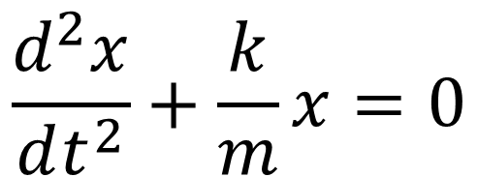

Reminder of previous lecture
Example of horizontal simple harmonic motion (SHM):
Spring constant (or spring coefficient)
$$\frac{d^{2}x}{dt^{2}}+\frac{k}{m}x=0$$
Using the Newton’s second law and ignoring all frictions:
Mass of the glider
Which the solution is:
$$x\left(t\right)=A\cos\left(ωt+φ\right)$$

Slide 6
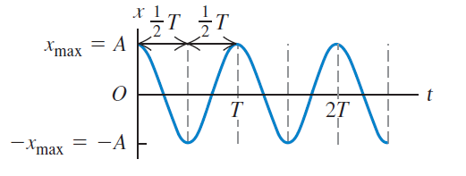

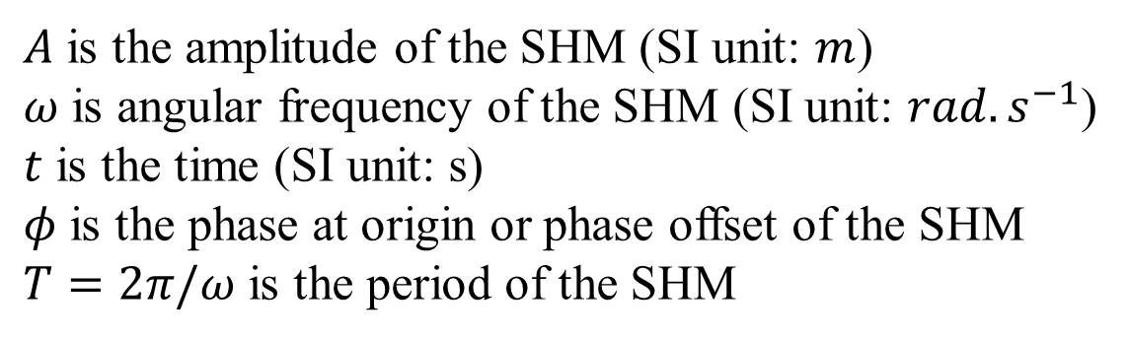
Reminder of previous lecture
$$x\left(t\right)=A\cos\left(ωt+φ\right)$$
$A$ is the amplitude of the SHM (SI unit: $m$)
$ω$ is angular frequency of the SHM (SI unit: $rad.s^{−1}$)
$t$ is the time (SI unit: s)
$φ$ is the phase at origin or phase offset of the SHM
$T=2π/ω$ is the period of the SHM

Slide 7


Phase (or phase angle) of a SHM
$$x\left(t\right)=A\cos\left(ωt+φ\right)$$
The term inside the cosines is an angle, named the “phase” or “phase angle” of the SHM
Reference circle of the SHM
$$ωt+φ$$
SHM is related with a uniform circular motion

Slide 8

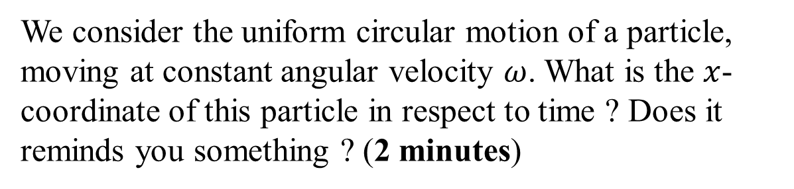



Circular motion and SHM: introduction
$$y$$
$$x_{max}$$
$$x$$
$$x\left(t\right)=?$$
We consider the uniform circular motion of a particle, moving at constant angular velocity $ω$. What is the $x$-coordinate of this particle in respect to time ? Does it reminds you something ? (2 minutes)

Slide 9




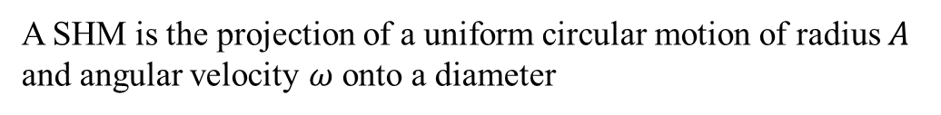


Circular motion and SHM
$$y$$
$$θ\left(t\right)=ωt+φ$$
$$x$$
$$x\left(t\right)$$
$$x_{max}=A$$
$$−x_{max}=−A$$
A SHM is the projection of a uniform circular motion of radius $A$ and angular velocity $ω$ onto a diameter
$$x\left(t\right)=A\cos{θ(t)}=A\cos\left(ωt+φ\right)$$
This circle is named “reference circle of the SHM ”

Slide 10




Circular motion and SHM
$$y$$
Q
$${\vec{a}}_{Q}$$
$$θ\left(t\right)=ωt+φ$$
P
$$x$$
$$x\left(t\right)$$
$$x_{max}=A$$
$$−x_{max}=−A$$
Q has a uniform circular motion, i.e. its acceleration is directed toward the center of the circle and has magnitude
$$a_{q}=ω^{2}A$$
P and Q have the same acceleration along the x-direction: $a_{x}$
$$a_{x}+ω^{2}x=0$$
$$a_{x}=−ω^{2}x=−ω^{2}Acos θ(t)$$

Slide 11





Phase angle in the reference circle
$$y$$
At $t=0$, for instance
$$θ\left(t\right)$$
$$φ=θ(t=0)$$
$$x$$
$$x\left(t\right)$$
$$x\left(t=0\right)$$
$$x\left(t\right)=A\cos{θ(t)}=A\cos\left(ωt+φ\right)$$
$$θ\left(t=0\right)=φ$$
Phase at origin (or phase offset )

Slide 12


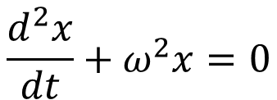
Summary
Simple harmonic motion (SHM), in the $x$-direction:
$$x\left(t\right)=A\cos\left(ωt+φ\right)$$
Important to remember
amplitude
Angular frequency
Phase at origin (or phase offset)
$$ω=\frac{2π}{T}=2πf$$
$T$ is the period of one cycle. $f$ is the frequency, i.e. the number of cycles per unit time,
Solution of the equation:
$$\frac{d^{2}x}{dt}+ω^{2}x=0$$
Important to remember

Slide 13
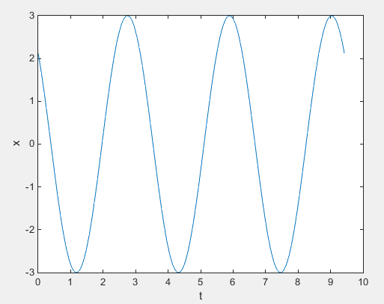
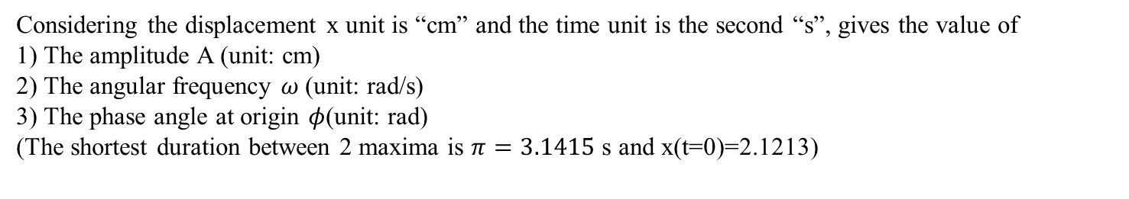
Graph of displacement x versus time t in a SHM (5 minutes)
Considering the displacement x unit is “cm” and the time unit is the second “s”, gives the value of
1) The amplitude A (unit: cm)
2) The angular frequency $ω$(unit: rad/s)
3) The phase angle at origin $φ$(unit: rad)
(The shortest duration between 2 maxima is $π=3.1415$ s and x(t=0)=2.1213)

Slide 14

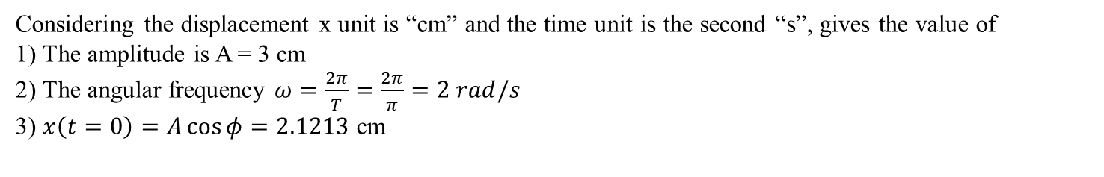
Graph of displacement x versus time t in a SHM: Solution
$$π=3.1415 s$$
Considering the displacement x unit is “cm” and the time unit is the second “s”, gives the value of
1) The amplitude is A = 3 cm
2) The angular frequency $ω=\frac{2π}{T}=\frac{2π}{π}=2 rad/s$
3) $x\left(t=0\right)=A\cos{φ=2.1213}$ cm
$$φ=arccos\left(\frac{x(t=0)}{A}\right)=arccos\left(\frac{2.1213}{3}\right)=0.7854 rad=\frac{π}{4} rad$$

Slide 15



Graph of displacement x versus time t in a SHM
$$x=A$$
$$x=A\cos{φ}$$
$$T=\frac{1}{f}=\frac{2π}{ω}$$
2A
Here, the function computed is $x=3\cos{(2t+π/4)}$

Slide 16





SHM with non-zero initial velocity
What if the glider has a initial velocity $v_{x}(t=0)≠0$ ?
$$at t=0, x\left(t\right)=x_{0},v_{x}\left(t=0\right)=v_{0,x}≠0$$
$$x\left(t\right)=A\cos\left(ωt+φ\right)$$
$$v_{x}\left(t\right)=−ωA\sin{(ωt+φ)}$$
$$x\left(t=0\right)=x_{0}=A\cos\left(φ\right)$$
$$x_{0}^{2}=A^{2}\cos^{2}φ$$
$$v_{x}\left(t=0\right)=v_{0,x}=−ωA\sin{(φ)}$$
$$v_{0,x}^{2}/ω^{2}=A^{2}\sin^{2}φ$$
$${x_{0}}^{2}+\frac{v_{0,x}^{2}}{ω^{2}}=A^{2}\left(\cos^{2}φ +\sin^{2}φ \right)=A^{2}$$

Slide 17
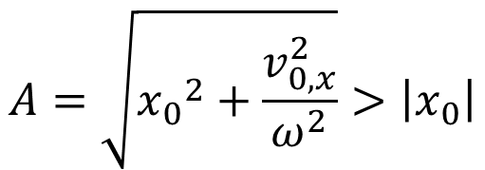
SHM with non-zero initial velocity
What if the glider has a initial velocity $v_{x}(t=0)≠0$ ?
$$at t=0, x\left(t\right)=x_{0},v_{x}\left(t=0\right)=v_{0,x}≠0$$
If at the initial time, we release the glider with a non-zero initial velocity $v_{0,x}$ at initial displacement from equilibrium $x_{0},$what happens for its motion ?
The net force and the spring force are described by the same way than previously, the Newton’s 2nd law is still applied by the same way than previously
The displacement of the glider is still described by:
$$x\left(t\right)=A\cos\left(ωt+φ\right)$$
But the amplitude of the SHM is:
$$A=\sqrt{{x_{0}}^{2}+\frac{v_{0,x}^{2}}{ω^{2}}}>\left|x_{0}\right|$$

Slide 18






Energy involved in SHM
We still consider the horizontal motion of a glider of mass $m$ associated with a spring, the friction is ignored.
The kinetic energy of the glider is:
$$E_{k}=\frac{1}{2}m{v_{x}}^{2}$$
The potential energy of the glider is:
$$E_{p}=\frac{1}{2}kx^{2}$$
where the equilibrium position $x=0$ is chosen to correspond to
$$E_{p}=0$$
Only the spring force does work on the glider (a conservative force), thus its mechanical energy $E_{m}$ is constant.
$$E_{m}=E_{p}+E_{k}=constant$$
When $x\left(t\right)=A, v_{x}\left(t\right)=0$
$$\frac{1}{2}m{v_{x}}^{2}+\frac{1}{2}kx^{2}=\frac{1}{2}kA^{2}$$

Slide 19
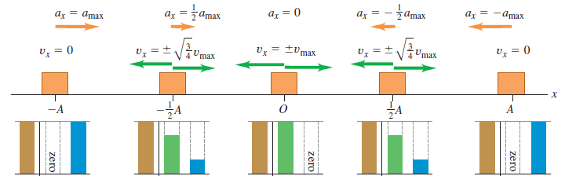


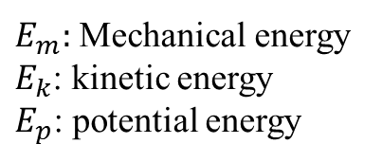















Energy involved in SHM
$$x=0$$
$$x$$
$$E_{m}$$
$$E_{k}$$
$$E_{p}$$
$$E_{m}$$
$$E_{k}$$
$$E_{p}$$
$$E_{m}$$
$$E_{k}$$
$$E_{p}$$
$$E_{m}$$
$$E_{k}$$
$$E_{p}$$
$$E_{m}$$
$$E_{k}$$
$$E_{p}$$
$E_{m}:$ Mechanical energy
$E_{k}$: kinetic energy
$E_{p}$: potential energy

Slide 20
Energy involved in SHM
$$x$$
$$E_{m}$$
$$E_{k}$$
$$E_{p}$$
$$E_{m}$$
$$E_{k}$$
$$E_{p}$$
$$E_{m}$$
$$E_{k}$$
$$E_{p}$$
$$E_{m}$$
$$E_{k}$$
$$E_{p}$$
$$E_{m}$$
$$E_{k}$$
$$E_{p}$$
$E_{m}:$ Mechanical energy
$E_{k}$: kinetic energy
$E_{p}$: potential energy

Slide 21

Energy involved in SHM
$$x$$
$$E_{m}$$
$$E_{k}$$
$$E_{p}$$
$$E_{m}$$
$$E_{k}$$
$$E_{p}$$
$$E_{m}$$
$$E_{k}$$
$$E_{p}$$
$$E_{m}$$
$$E_{k}$$
$$E_{p}$$
$$E_{m}$$
$$E_{k}$$
$$E_{p}$$
$E_{m}:$ Mechanical energy
$E_{k}$: kinetic energy
$E_{p}$: potential energy

Slide 22
Energy involved in SHM
$$x$$
$$E_{m}$$
$$E_{k}$$
$$E_{p}$$
$$E_{m}$$
$$E_{k}$$
$$E_{p}$$
$$E_{m}$$
$$E_{k}$$
$$E_{p}$$
$$E_{m}$$
$$E_{k}$$
$$E_{p}$$
$$E_{m}$$
$$E_{k}$$
$$E_{p}$$
$E_{m}:$ Mechanical energy
$E_{k}$: kinetic energy
$E_{p}$: potential energy

Slide 23
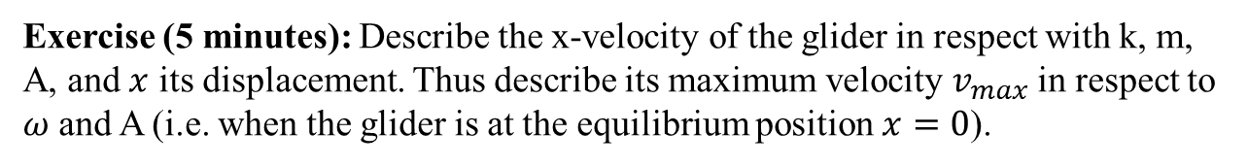
Energy involved in SHM
$$E_{m}$$
$$E_{k}$$
$$E_{p}$$
$$E_{m}$$
$$E_{k}$$
$$E_{p}$$
$$E_{m}$$
$$E_{k}$$
$$E_{p}$$
$$E_{m}$$
$$E_{k}$$
$$E_{p}$$
$$E_{m}$$
$$E_{k}$$
$$E_{p}$$
$E_{m}:$ Mechanical energy
$E_{k}$: kinetic energy
$E_{p}$: potential energy
Exercise (5 minutes): Describe the x-velocity of the glider in respect with k, m, A, and $x$ its displacement. Thus describe its maximum velocity $v_{max}$ in respect to $ω$ and A (i.e. when the glider is at the equilibrium position $x=0$).

Slide 24
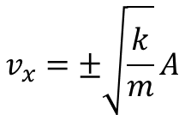



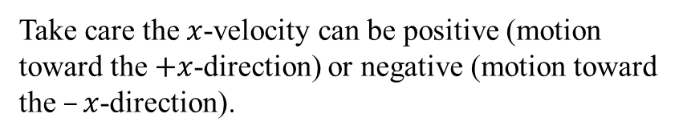
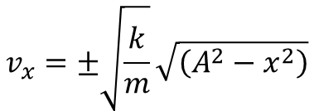


Energy involved in SHM
$$\frac{1}{2}m{v_{x}}^{2}+\frac{1}{2}kx^{2}=\frac{1}{2}kA^{2}$$
$$m{v_{x}}^{2}=kA^{2}−kx^{2}$$
$$v_{x}^{2}=\frac{k}{m}\left(A^{2}−x^{2}\right)$$
$$v_{x}=±\sqrt{\frac{k}{m}}\sqrt{\left(A^{2}−x^{2}\right)}$$
Take care the $x$-velocity can be positive (motion toward the $+x$-direction) or negative (motion toward the $–x$-direction).
$$v_{x}=±\sqrt{\frac{k}{m}}A$$
At $x=0$,
$$v_{max}=ωA$$

Slide 25
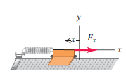



Phase difference between two SHMs
We wish to study the motion of two gliders in horizontal motion associated with spring. The origin of time must be the same for both motions !
$$1$$
$$glider 1$$
2
$$glider 2$$

Slide 26






Phase difference between two SHMs
We wish to study the motion of two gliders in horizontal motion associated with spring. The origin of time must be the same for both motions !
$$x(t)$$
Reference circle:
$$t$$
$$x_{1}=A_{1}\cos\left(ωt+φ_{1}\right)$$
Phase difference:
$$Δφ=φ_{2}−φ_{1}$$
$$x_{2}=A_{2}\cos\left(ωt+φ_{2}\right)$$
Here, $Δφ=φ_{2}−φ_{1}=π/2$

Slide 27
Other examples of SHM
Different kinds of spring-mass systems, here the weight and/or the normal force could be involved …

Slide 28
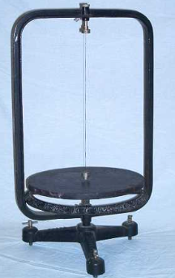
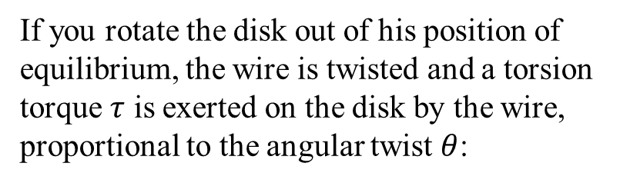
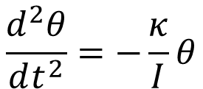


Angular SHM with a torsion pendulum (friction ignored)
If you rotate the disk out of his position of equilibrium, the wire is twisted and a torsion torque $τ$ is exerted on the disk by the wire, proportional to the angular twist $θ$:
wire
$$τ=−κθ$$
Using the rotational equivalent to the Newton’s 2nd law, we obtain the angular acceleration described by:
disk
$$\frac{d^{2}θ}{dt^{2}}=−\frac{κ}{I}θ$$
$$θ$$
Where I is the moment of inertia of the disk about the axis of rotation
http://physics.kenyon.edu/EarlyApparatus/Mechanics/Torsion_Pendulum/Torsion_Pendulum.html

Slide 29


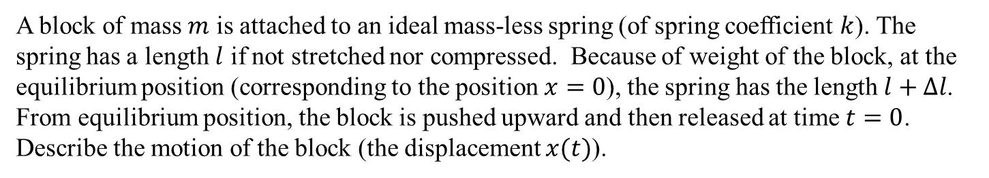



Ex: A vertical spring-mass system (friction ignored)
$$l$$
Take care that at equilibrium position, there is a spring force exerted on the block because the spring has been stretched.
$$∆l$$
$$x$$
$$x=0$$
A block of mass $m$ is attached to an ideal mass-less spring (of spring coefficient $k$). The spring has a length $l$ if not stretched nor compressed. Because of weight of the block, at the equilibrium position (corresponding to the position $x=0$), the spring has the length $l+Δl$. From equilibrium position, the block is pushed upward and then released at time $t=0$.
Describe the motion of the block (the displacement $x(t)$).

Slide 30
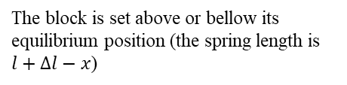

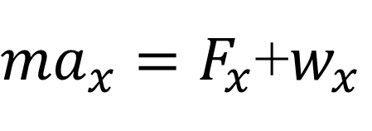


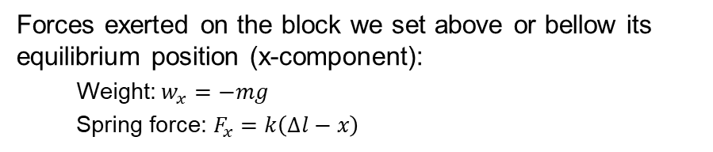

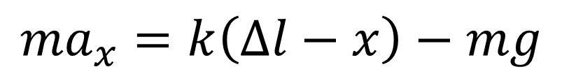
Ex: A vertical spring-mass system (friction ignored)
Forces exerted on the block we set above or bellow its equilibrium position (x-component):
Weight: $w_{x}=−mg$
Spring force: $F_{x}=k\left(∆l−x\right)$
$$l$$
Using the Newton’s second law:
$$∆l$$
${ma}_{x}=F_{x}$+$w_{x}$
$$x$$
$$x=0$$
$${ma}_{x}=k\left(∆l−x\right)−mg$$
The block is set above or bellow its equilibrium position (the spring length is $l+∆l−x$)
x-component of the acceleration

Slide 31
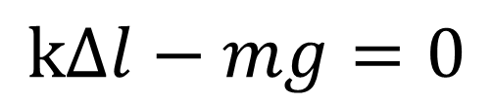
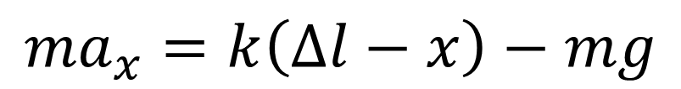


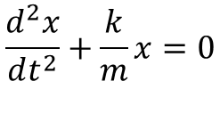
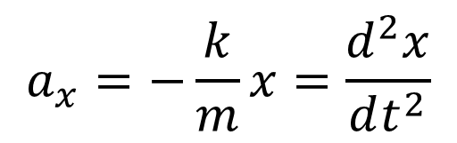
Ex: A vertical spring-mass system (friction ignored)
And by applying Newton’s 2nd law when the block is at equilibrium position:
$$l$$
$$k∆l−mg=0$$
$${ma}_{x}=k\left(∆l−x\right)−mg$$
$$∆l$$
$$x$$
$$x=0$$
$$a_{x}=−\frac{k}{m}x=\frac{d^{2}x}{dt^{2}}$$
$$\frac{d^{2}x}{dt^{2}}+\frac{k}{m}x=0$$
$$x\left(t\right)=A\cos\left(ωt+φ\right)$$
$$ω=\sqrt{k/m}$$

Slide 32
End of the lecture 11

